Slide 1
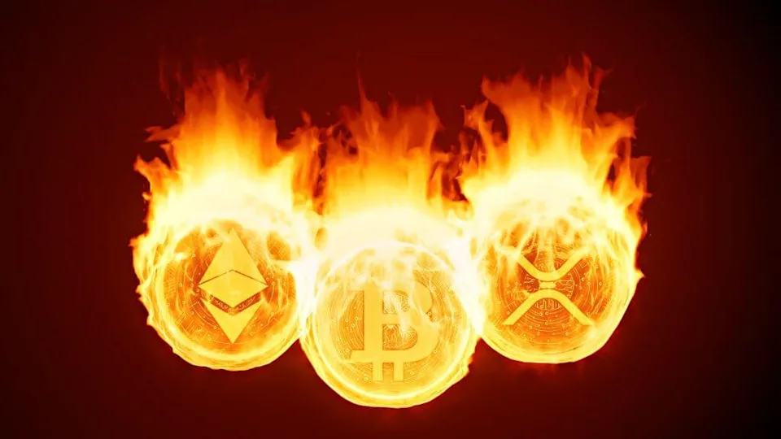
Proof of Burn
P. Abhiram reddy
CB.EN.P2CYS20021

Slide 2
Definition
Proof of Burn (PoB) is a particular consensus protocol in which miners gain the power to mine a block by “burning” a portion of the tokens they have in their possession. That is, the mining capacity is given to the miner who spends a part of his money for the right to mine a block and claim his reward.

Slide 3
History of the Consensus Algorithm
This protocol was designed by Iain Stewart, who he presented his idea about Proof of Burn, on the popular Bitcointalk forum, in December 2012. Iain uses an analogy to describe the algorithm: burned coins are like mining rigs. In this analogy, a miner burns his coins to buy a virtual mining rig that gives him the power to mine blocks. The more coins burned by the miner, the larger his virtual mining “platform” will be.

Slide 4
Need of Proof of Burn Consensus Algorithm
The most well-known type of consensus-generating algorithms is called proof of work (POW). In a POW system, miners are rewarded for updating the blockchain. This entails using computing power to solve a mathematical equation and results in a monetary reward. Bitcoin, the original and most popular cryptocurrency, uses a POW system.
The biggest disadvantage of proof-of-work centers on the computational capabilities needed to solve mathematical problems in authenticating blockchain transactions have negative environmental impacts.Because the POW method is so resource-intensive, it's not very efficient.

Slide 5
Need of Proof of Burn Consensus Algorithm
Proof of stake (POS) is another algorithm that allots mining rights to miners proportional to their stakes held in the cryptocurrency.In this system, the blockchain is maintained by a randomly selected group of validators who “stake” the native network tokens by locking them into the blockchain to produce and approve blocks.
Validators, on the other hand, are individuals chosen randomly to validate transactions after they have staked their coins. Although they are chosen at random, users with a larger stake usually have a better chance of being selected. Because ot this benefits flow increasingly to the largest coin holders, in a POS system, the richer you are, the richer you get. And the stacked coins can be sold at any time so inflation can be possible.

Slide 6
Need of Proof of Burn Consensus Algorithm
POB is often called a POW system without energy waste. It operates on the principle of allowing miners to “burn” virtual currency tokens. They are then granted the right to write blocks in proportion to the coins burnt. So here no resources are wasted for mining the block.
One thing that PoB and PoS have in common is the fact that the block validators have to invest their coins in order to participate in the consensus mechanism. However, PoS blockchains require forgers to stake their coins, usually locking them up. But if they decide to leave the network, they may take those coins back and sell them in the market. Therefore, there is no permanent market scarcity in such a scenario because coins are only taken out of circulation for a certain period of time. On the other hand, PoB block validators have to destroy their coins forever, creating a permanent economic scarcity. And we can also impose the panality on fradulent transaction same as proof of stack.

Slide 7
Proof of Burn working
The Proof of Burn (PoB) consensus protocol has a very particular way of reaching consensus and validating transactions within the blockchain. In the, miners must send cryptocurrencies to a verifiable public address. This address is known as eater addresses o dining direction, from where they will never be able to obtain them again. That is, miners must make a kind of investment in the blockchain with cryptocurrencies. And because of the greater number of cryptocurrencies burned in the network, the greater the mining power that the miner reaches.
In other words, miners must invest in the blockchain to demonstrate their commitment to the network. In this sense, this protocol is closely related to the Proof of Work (PoW). The difference is that miners should not invest in expensive and powerful computing equipment, but rather in tokens and cryptocurrencies.

Slide 8
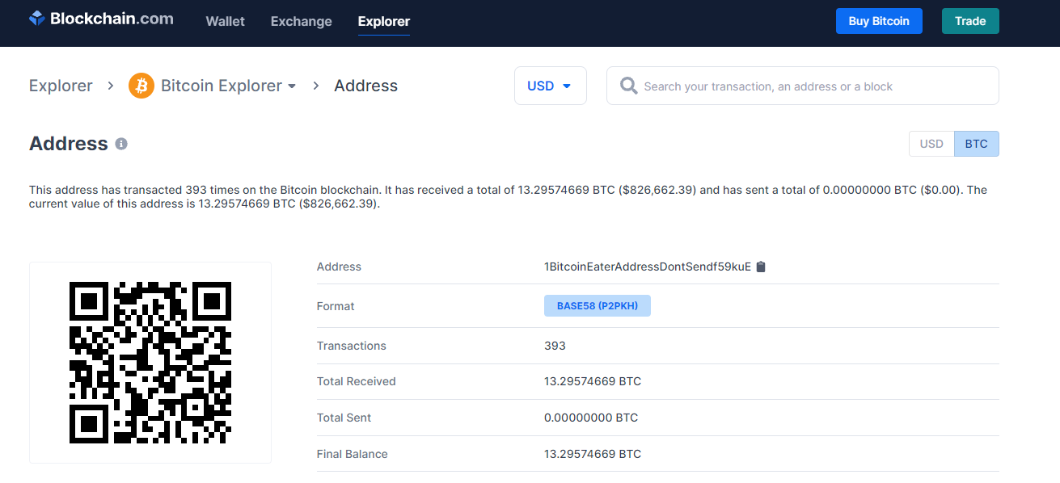

Slide 9
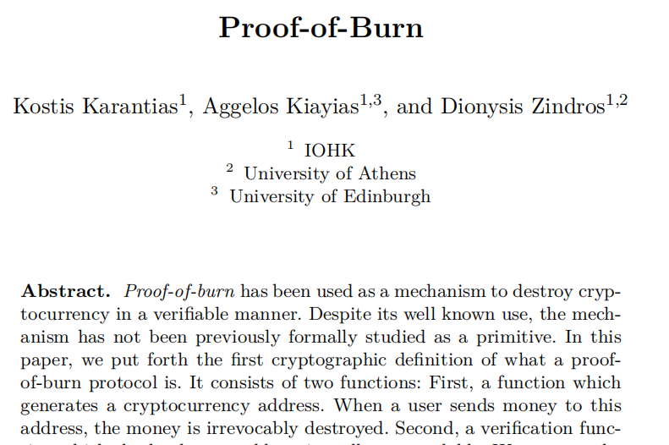
Proof of Burn paper

Slide 10
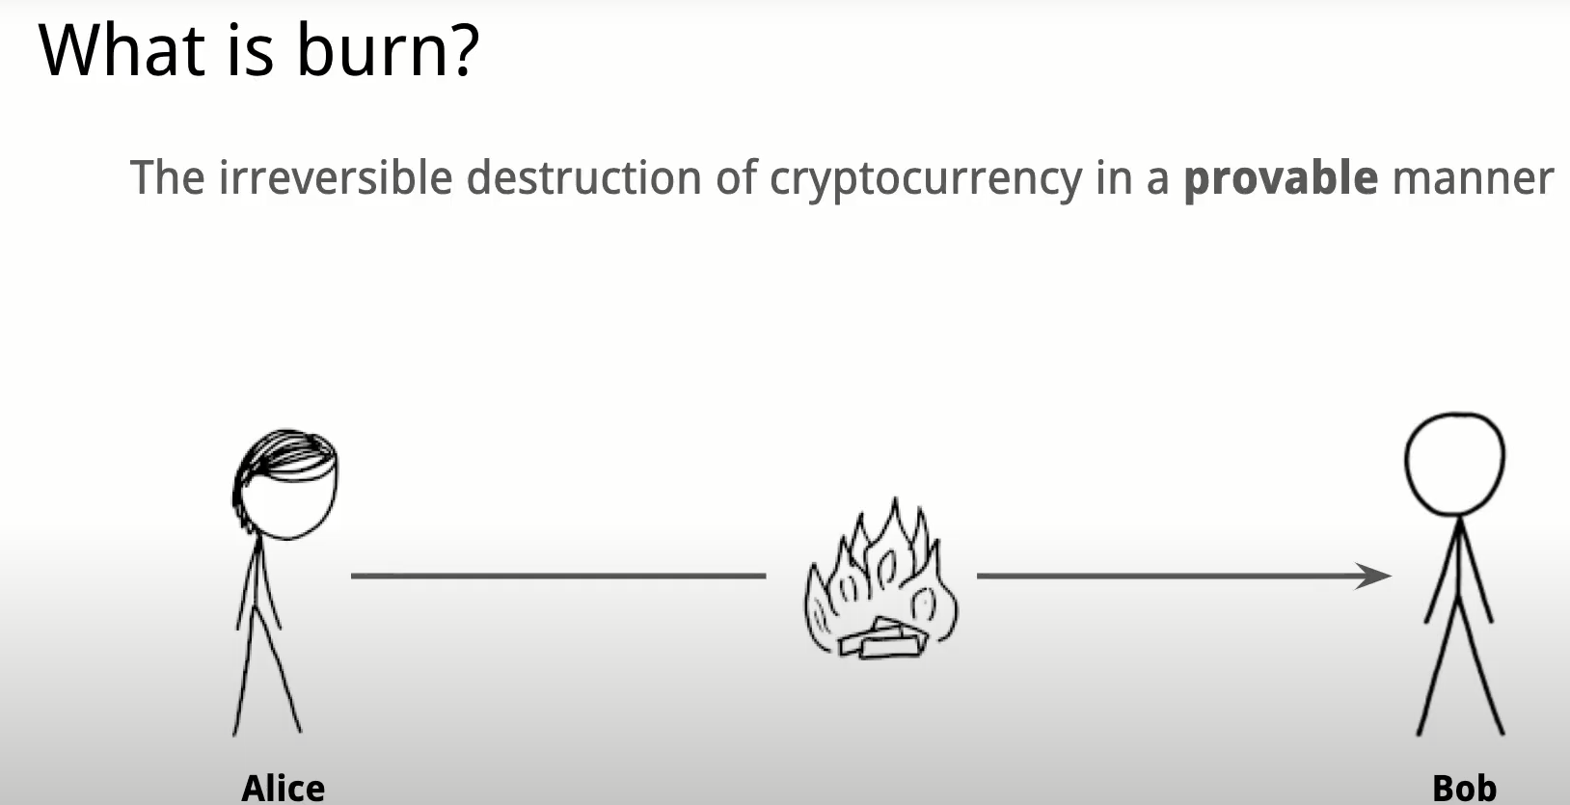

Slide 11
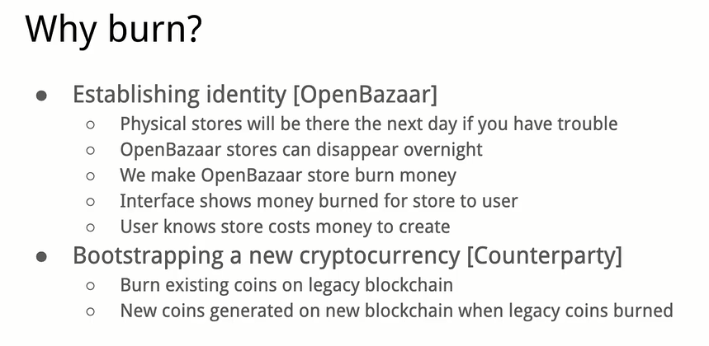

Slide 12
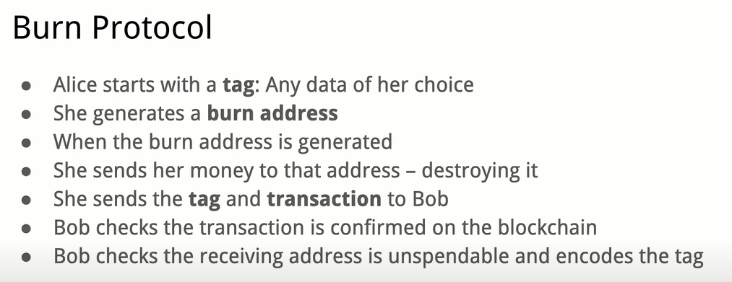

Slide 13
Proof-of-burn has been used as a mechanism to destroy cryptocurrency in a verifiable manner.
It consists of two functions: First, a function whichgenerates a cryptocurrency address. When a user sends money to this address, the money is irrevocably destroyed. Second, a verification function which checks that an address is really unspendable.
We propose the following properties for burn protocols.
correctness
Unspendability
Binding
Uncensorability

Slide 14
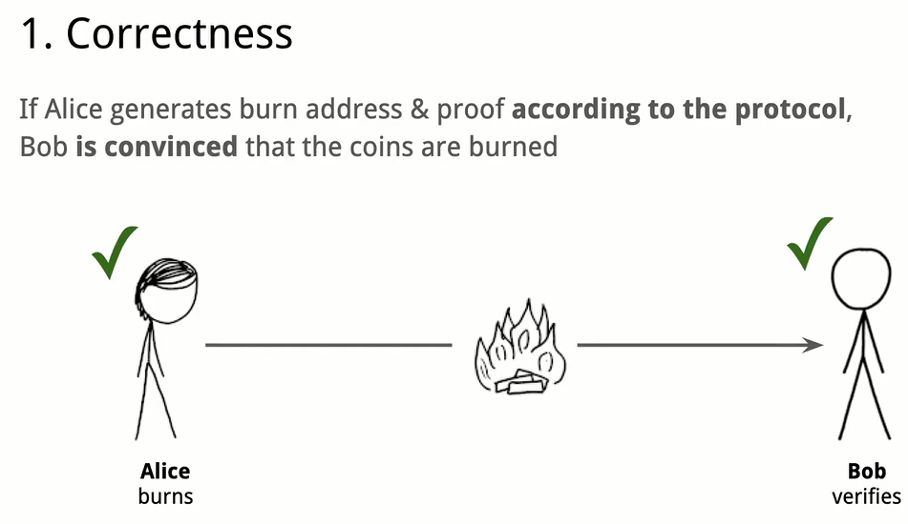

Slide 15
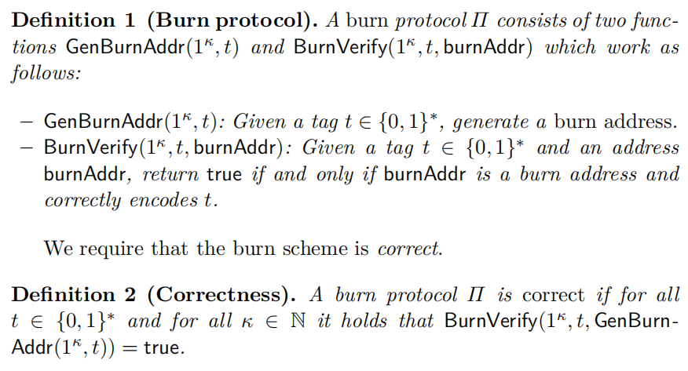

Slide 16
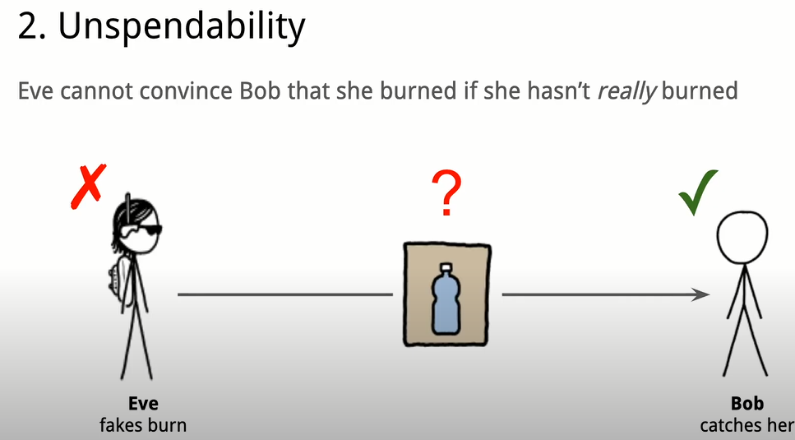

Slide 17
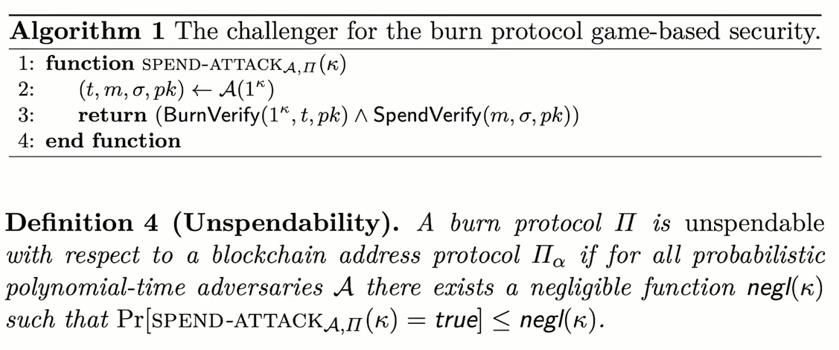

Slide 18
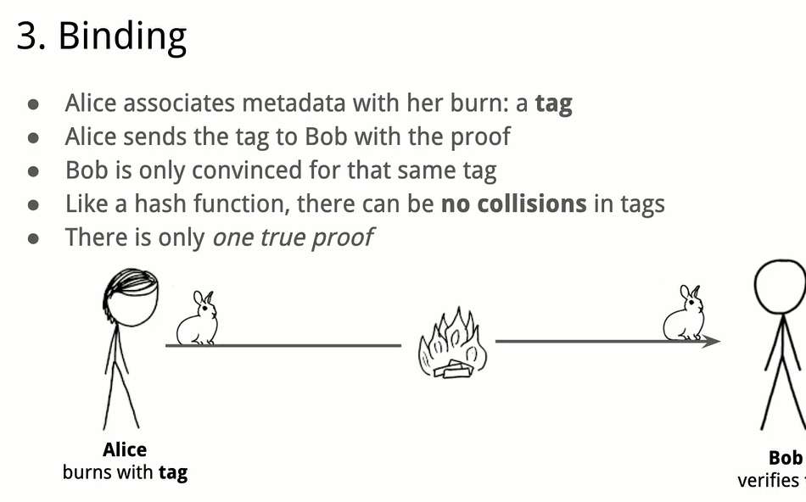

Slide 19
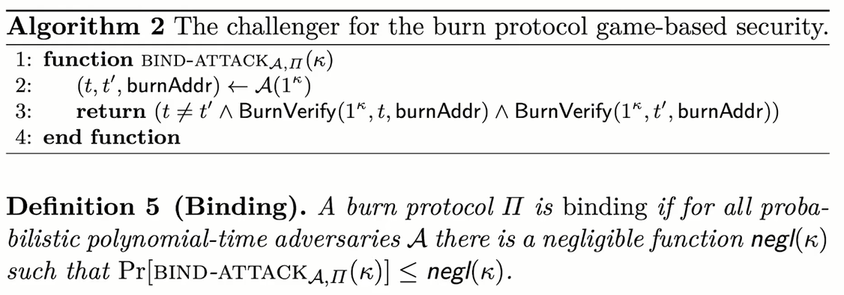

Slide 20
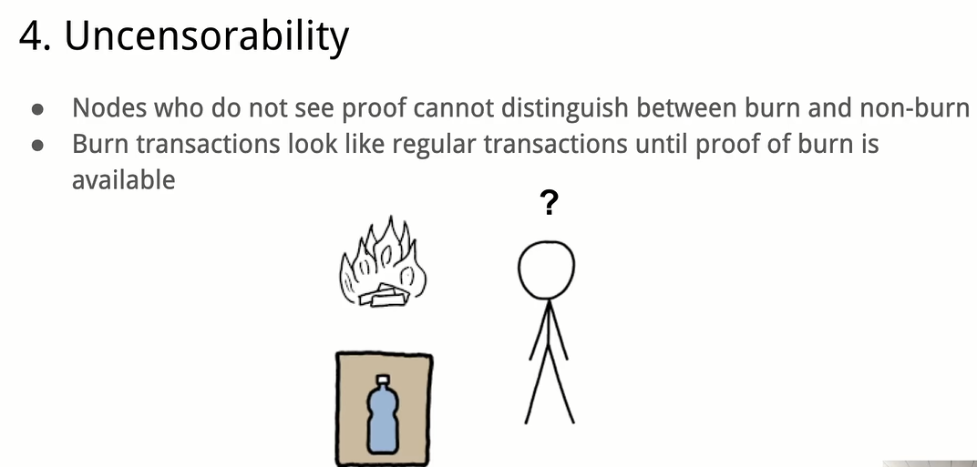
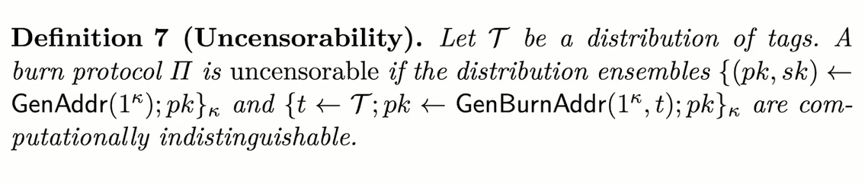

Slide 21
Advantages
More sustainable. Reduced power consumption.
No need for mining hardware. Coin burns are virtual mining rigs.
Coin burns reduce the circulating supply (market scarcity).
Encourages long-term commitment by the miners.
Coin distribution/mining tends to be less centralized

Slide 22
Disadvantages
Some say that PoB is not really eco-friendly because the Bitcoins being burned are generated through PoW mining, which requires lots of resources.
Not proven to work on larger scales. More testing is needed to confirm its efficiency and security.
The process of burning coin is not always transparent or easily verifiable by the average user.
Proof-of-burn has also been called a high risk protocol, as there is no guarantee that a user will ever recover the full value of the coin being burned.

Slide 23
Examples and Real-Time Usecases
Examples of implementations of proof of burn include Slimcoin (SLM) and Counterparty(XCP).
In the case of Slimcoin, proof of burn is used as its consensus algorithm and mining method.
In contrast, Counterparty uses proof of burn for seeding its tokens. Those participating sent bitcoins to an unspendable Bitcoin address and received the Counterparty tokens in return.
Satozhi (SATOZ) is the first token in the world to use this new protocol. This protocol uses the logicof burning the token supply in the block chain, and then creating a new token in the pool every 10 minutes.

Slide 24
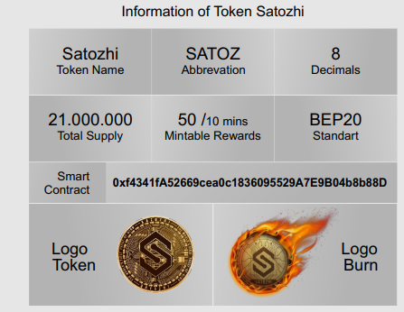
Examples and Real-Time Usecases
There are 3 Types of SATOZ HOLDER
1. TRADERS: Users who only buy SATOZ and keep it in their smart wallet and wait for the price increase, as a store of value.
2. SUPPLIER: Users who buy SATOZ then burn it, and will get SATOZ prizes in their smart wallet every 10 minutes automatically.
3. LIQUIDATOR: Users who buy and liquidate SATOZ into a pool (such as PancakeSwap), with the same or different pairs.

Slide 25
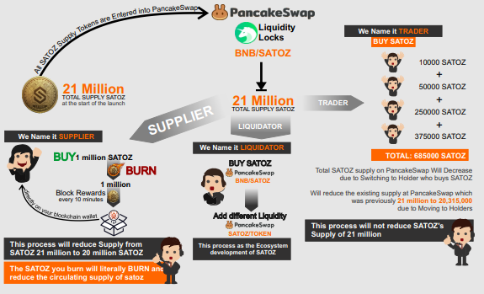

Slide 26
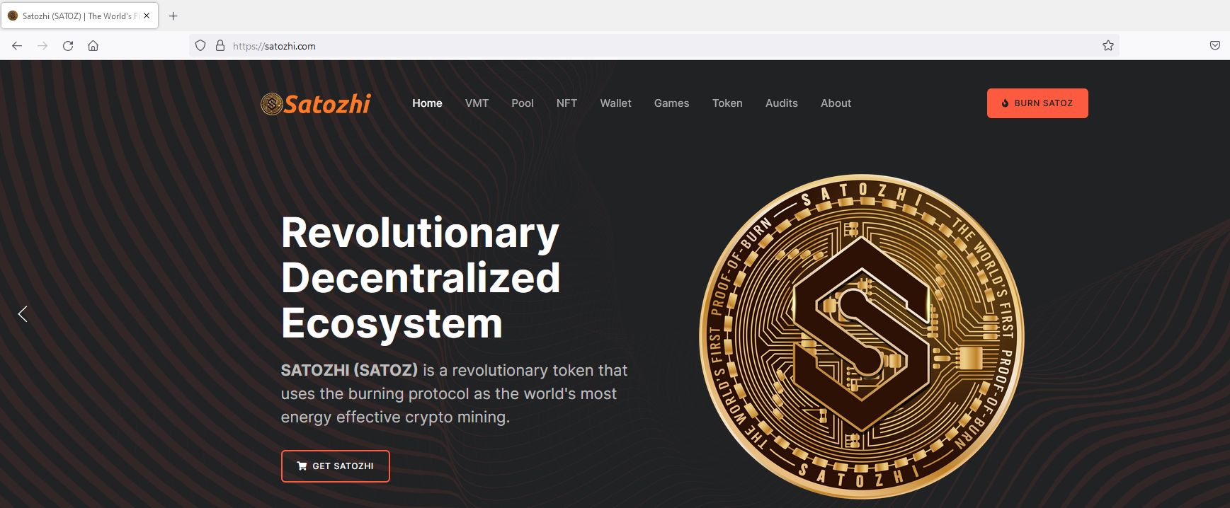
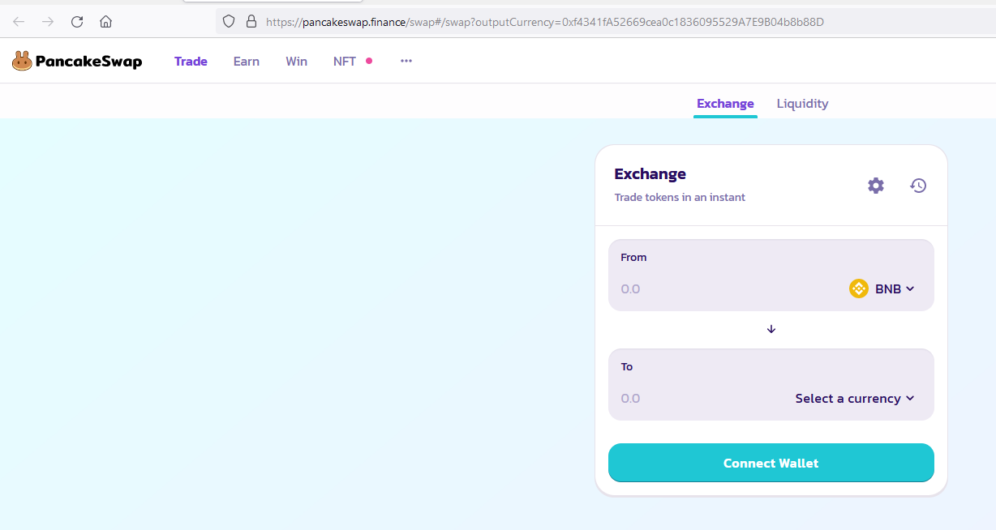

Slide 27
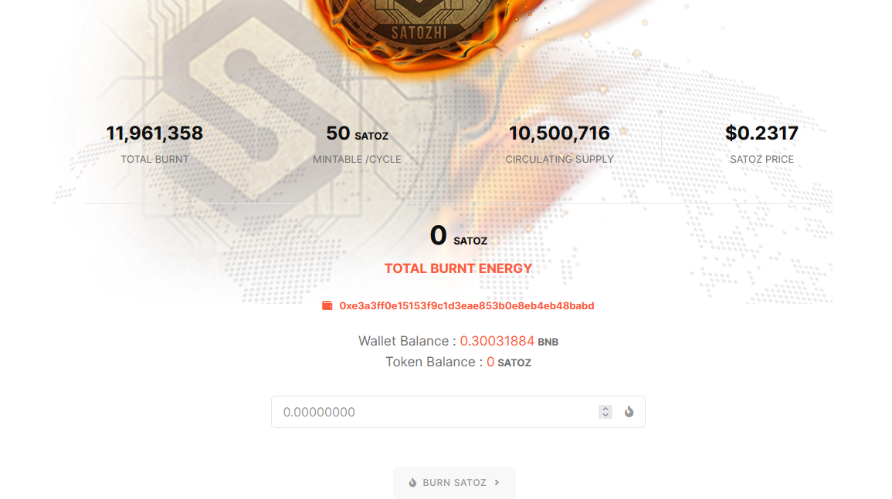
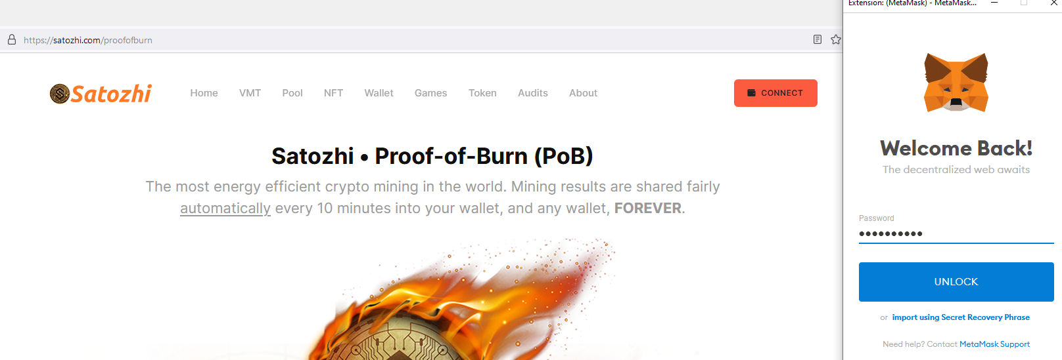

Slide 28


